Slide 1


Binary Symmetric Channel (BSC)
The channel flips input bit with probability 𝑝 or passes the input bit unchanged with probability 1 − 𝑝.

Slide 2

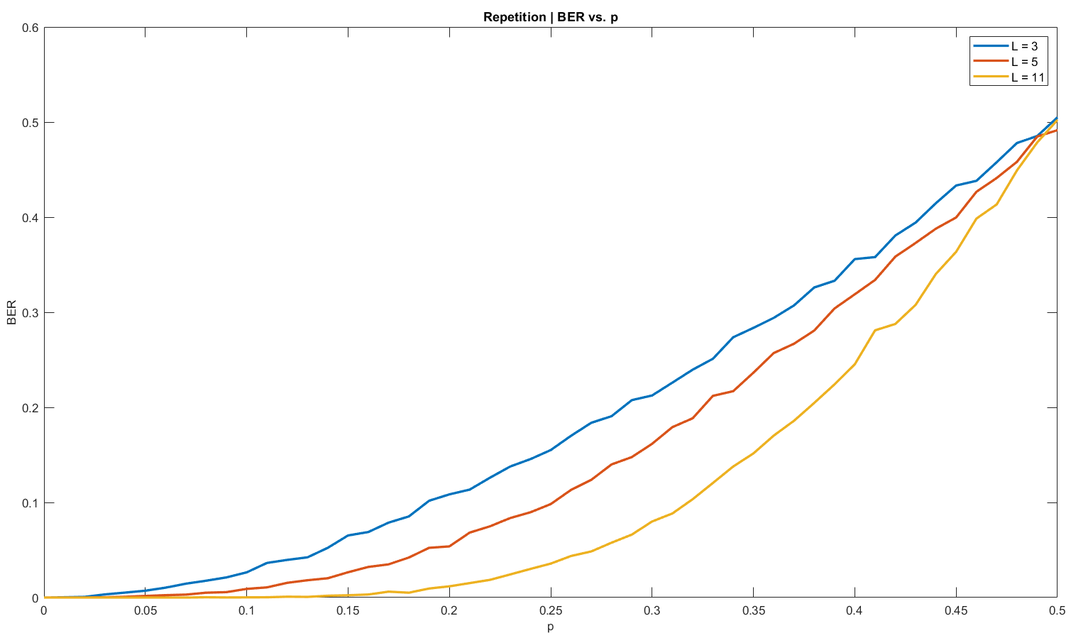
L = 3, 5, 11 (ODD)
Majority Rule Vote

Slide 3

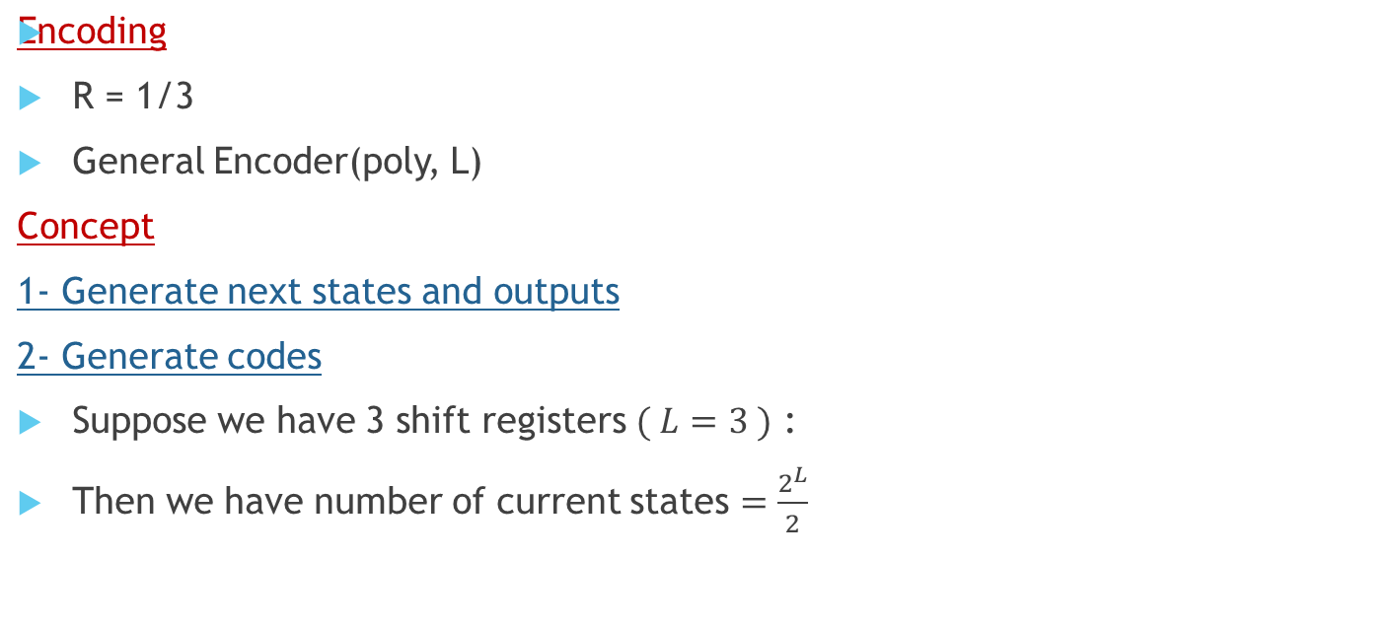
0 | 0
0 | 1
1 | 0
1 | 1

Slide 4

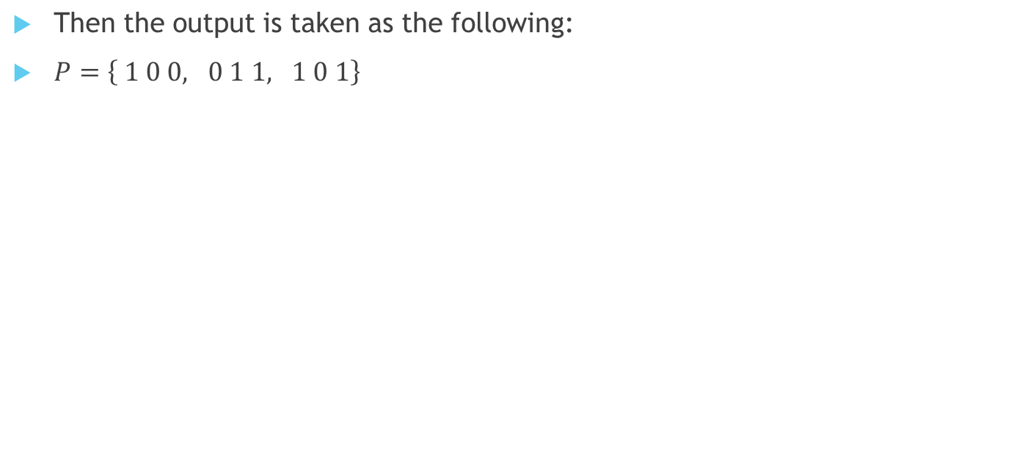
input | current states
0 | 0 | 0
0 | 0 | 1
0 | 1 | 0
0 | 1 | 1
1 | 0 | 0
1 | 0 | 1
1 | 1 | 0
1 | 1 | 1
next states
0 | 0 | 0
0 | 0 | 1
0 | 1 | 0
0 | 1 | 1
1 | 0 | 0
1 | 0 | 1
1 | 1 | 0
1 | 1 | 1

Slide 5
input | current states
0 | 0 | 0
0 | 0 | 1
0 | 1 | 0
0 | 1 | 1
1 | 0 | 0
1 | 0 | 1
1 | 1 | 0
1 | 1 | 1
next states
0 | 0 | 0
0 | 0 | 1
0 | 1 | 0
0 | 1 | 1
1 | 0 | 0
1 | 0 | 1
1 | 1 | 0
1 | 1 | 1
Output
0 | 0 | 0
0 | 1 | 1
0 | 1 | 0
0 | 0 | 1
1 | 0 | 1
1 | 1 | 0
1 | 1 | 1
1 | 0 | 0

Slide 6
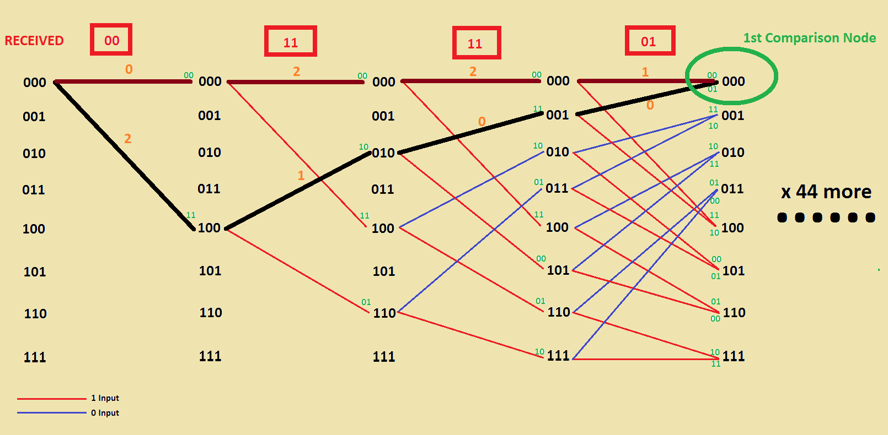
Decoding (Viterbi Decoder)
Transient State
Steady State
R = 1/3
General Encoder(poly, L)

Slide 7
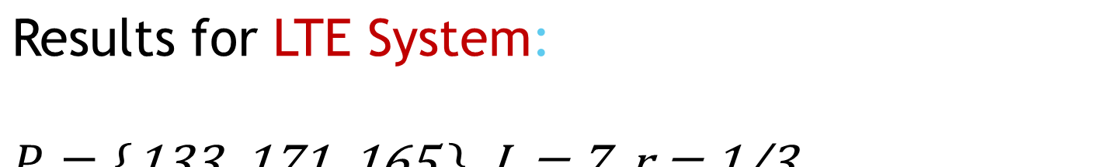
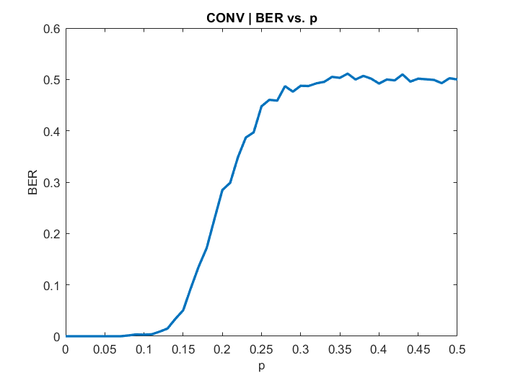

Slide 8

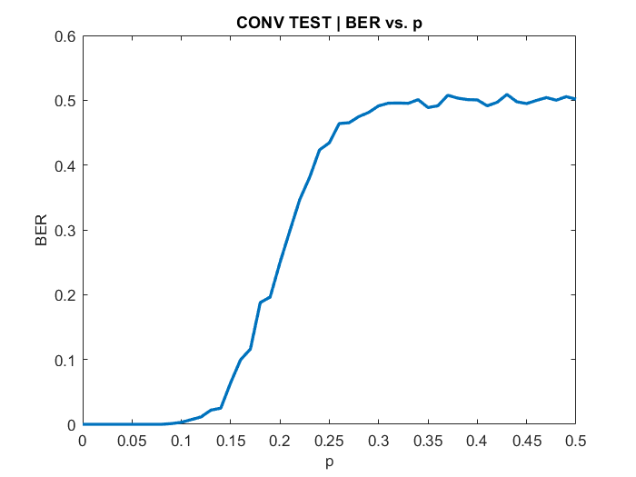

Slide 9
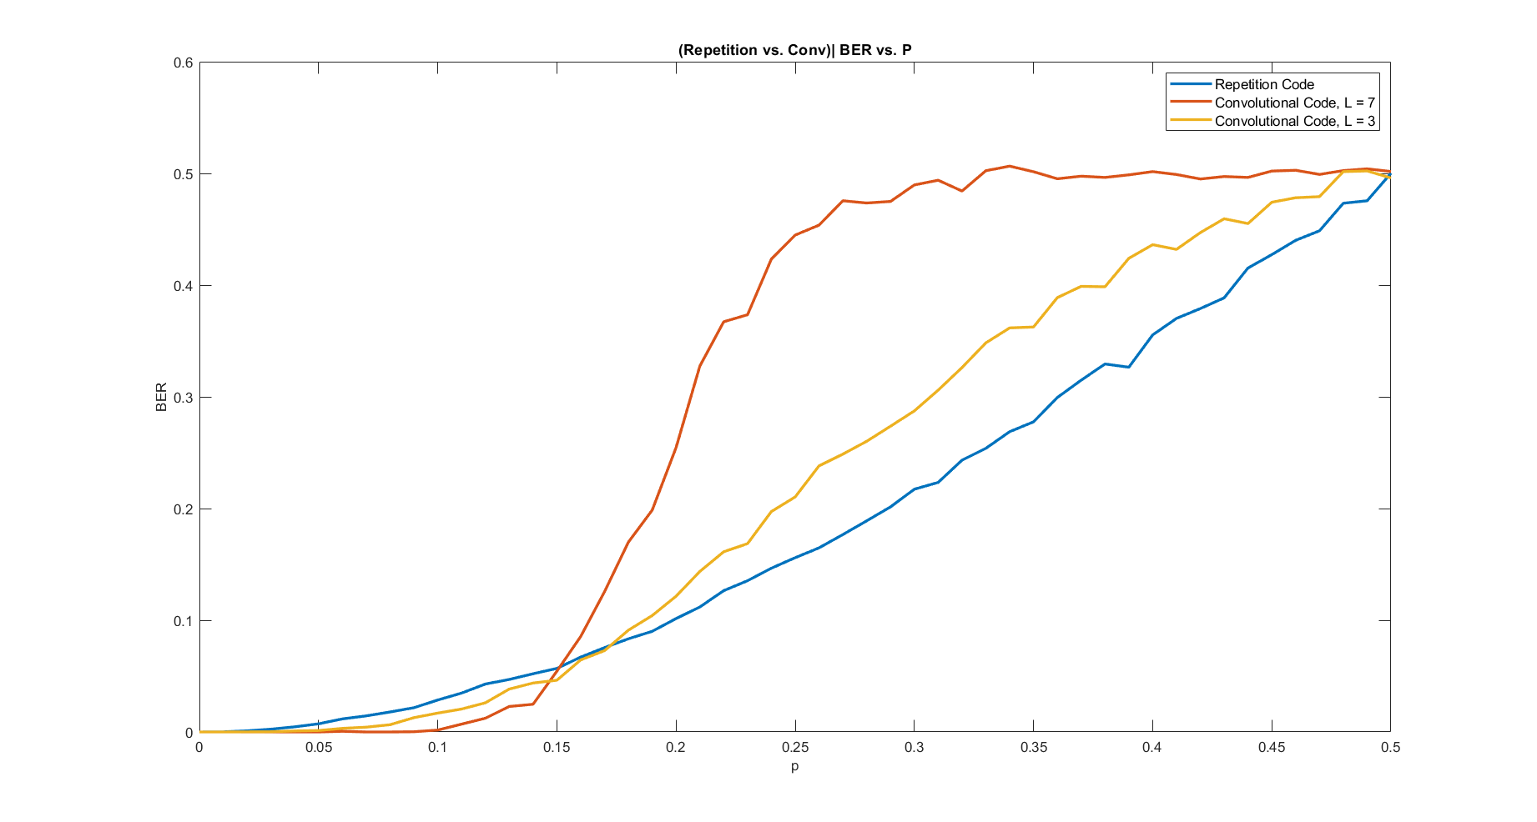
Comparison between repetition and convolutional codes:

Slide 10
Comparison between repetition and convolutional codes:

Slide 11

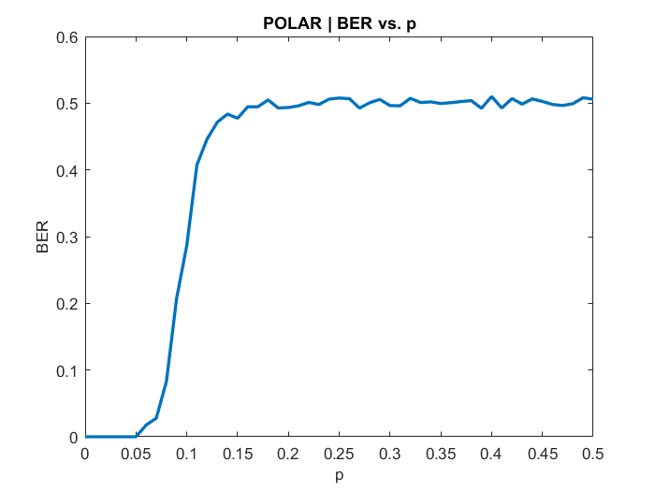
Encoding
Reliability Sequence ( 3GPP Std.)
Kernel composed of G2 matrix.
PBSK Modulation.
Decoding (SC) “Binary tree”
At each node there is left, right, and up Op.
Left: minimum sum
Right: depends on the result of the left operation.
Up: update belief in node .

Slide 12
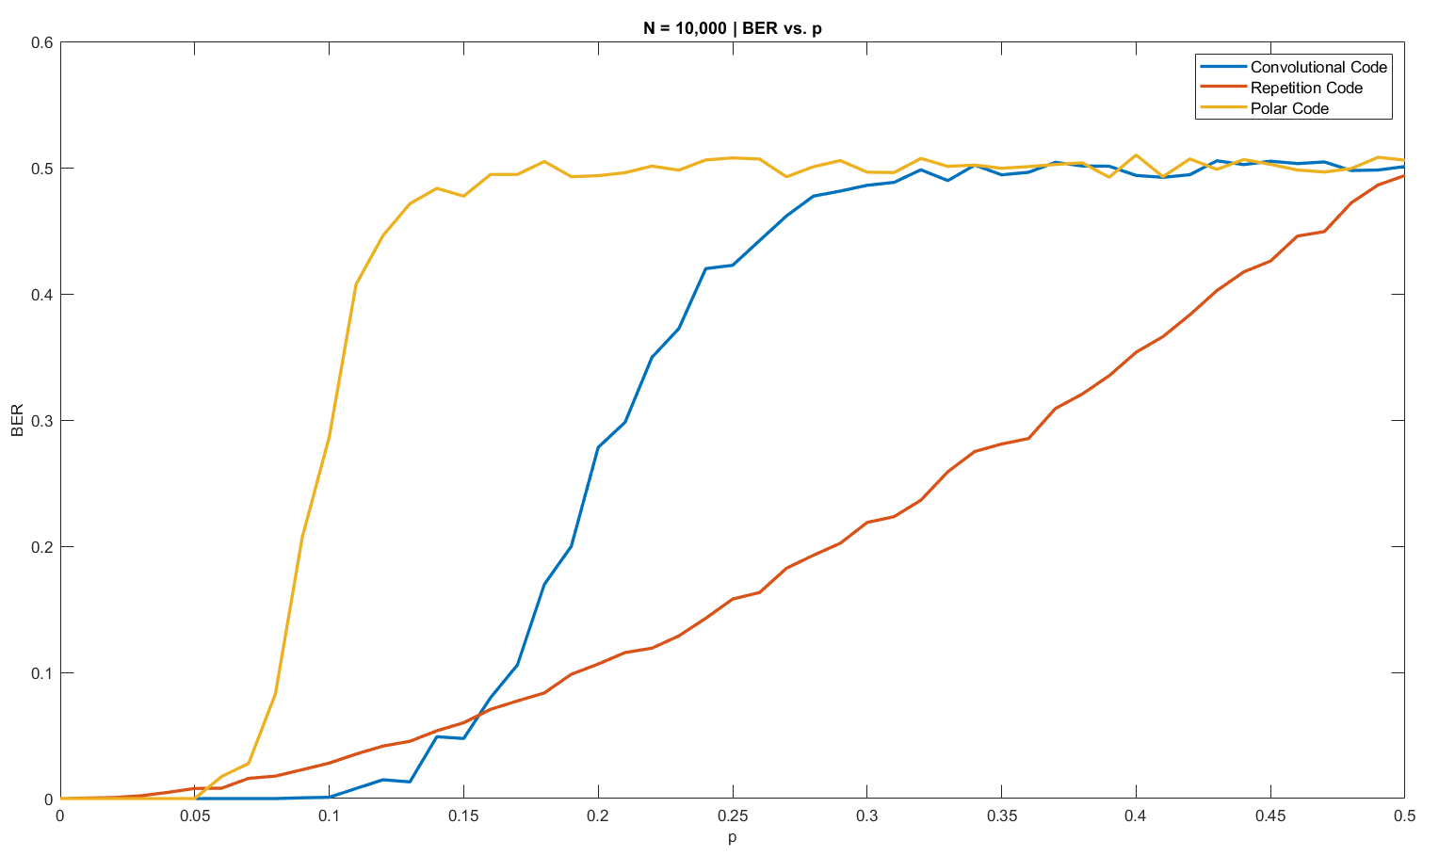
Comparison between repetition, convolutional, and polar codes:

Slide 13

Decoding data into block by block.

Slide 14
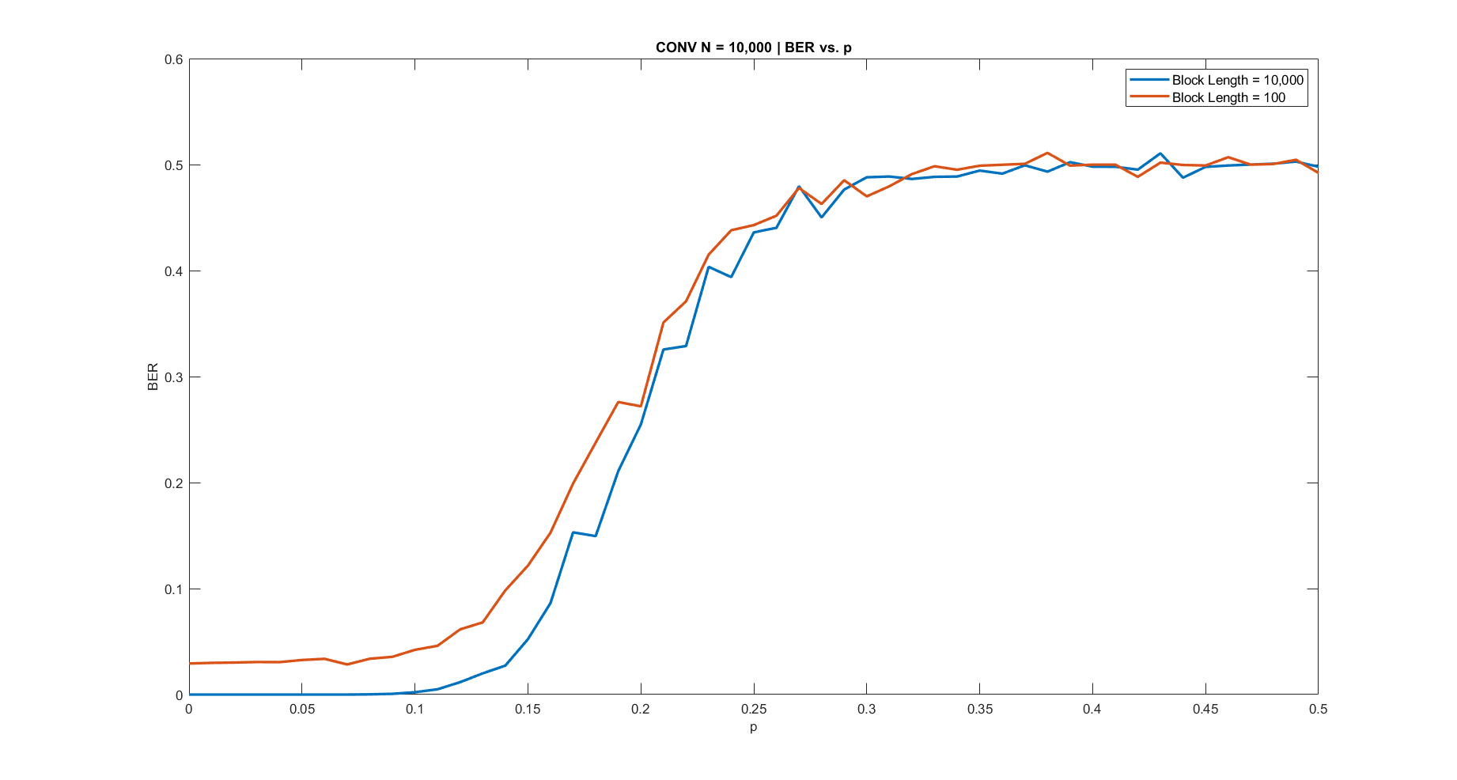

Slide 15
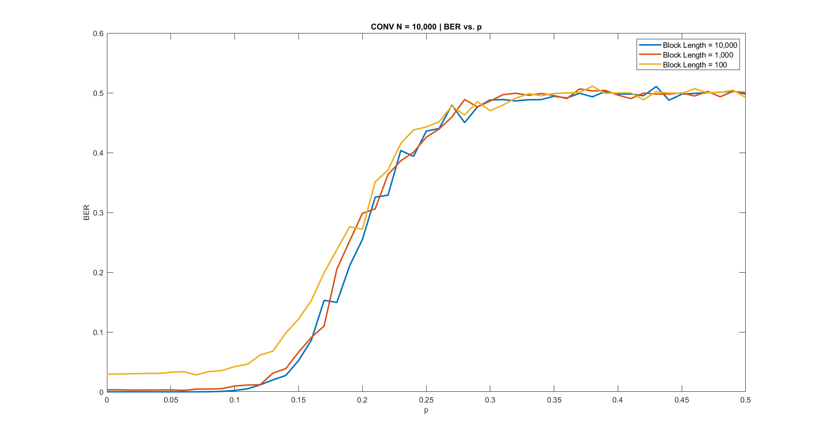

Slide 16
Research Outcomes
To divide data into blocks:
1- increase block length
2- tail biting encoding and wrap-around Viterbi algorithm decoding
If data is divided into small data blocks, BER increases and it has slower response. (*vectorization is better)

